Slide 1
Interpreting modelling results
The results provide insights on questions such as:
Which technologies are phasing out? By when?
What are the optimal investments in new technologies to meet the demand in the future? When is it best to invest?
What are the key generation technologies in the total energy mix?
Which capacities are NOT being utilized? Why?
What costs will the energy system incur?

Slide 2
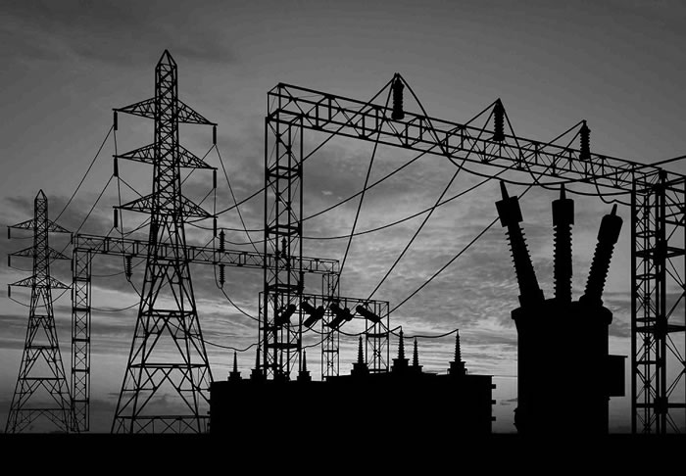

Interpreting modelling results
What needs to be done and what will be the costs to supply modern energy sources to remote areas?
What if environmental regulations are made more stringent?
What needs to be done to increase the share of renewable technologies?
Should the electricity import be allowed?
Should the existing nuclear facilities be closed down?
Can energy conservation program help in reducing cost of energy supply?

Slide 3
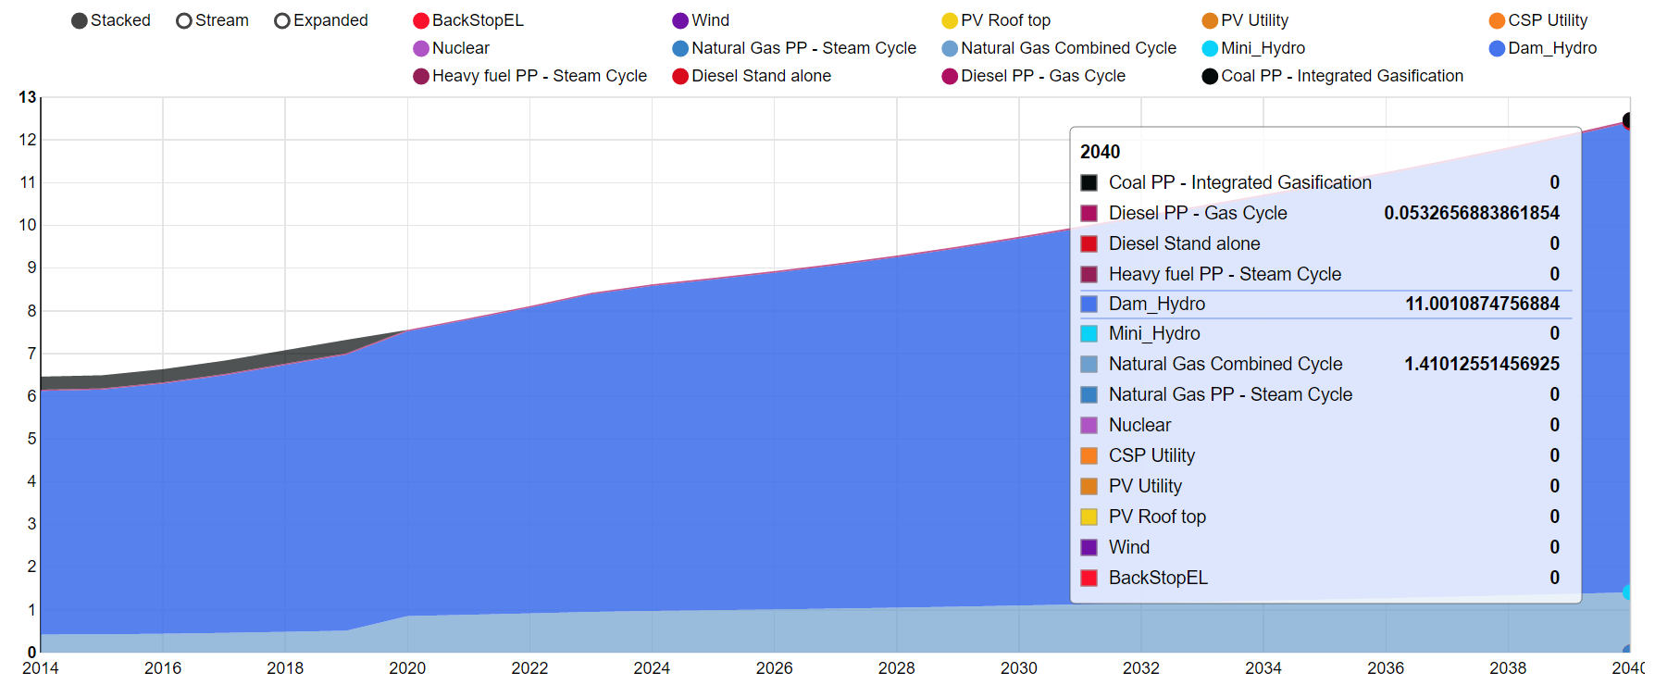
Representative OSeMOSYS results
Hydro and CCGT most competitive
Electricity Generation (PJ)
Initial capacity of COAL PP phased out at end of life
Year

Slide 4
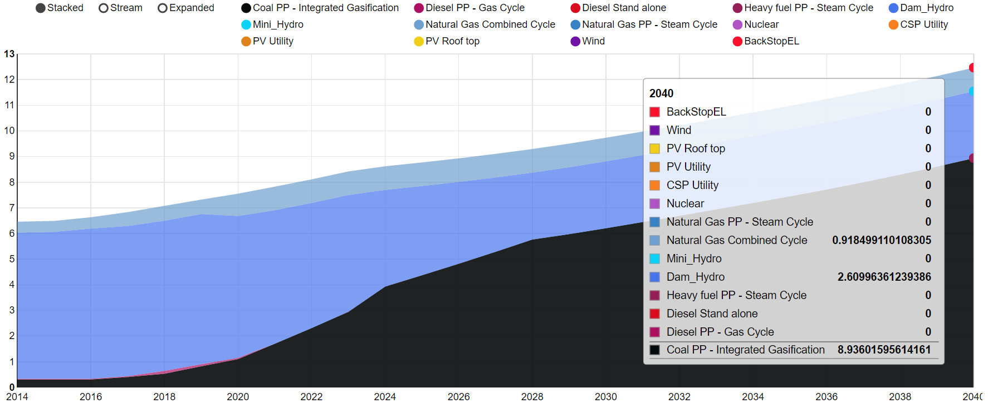
Representative OSeMOSYS results
What happens in a climate ‘water scarcity’ scenario?
Electricity Generation (PJ)
More generation from COAL PP, less reliance on HYDRO
Year

